Slide 1
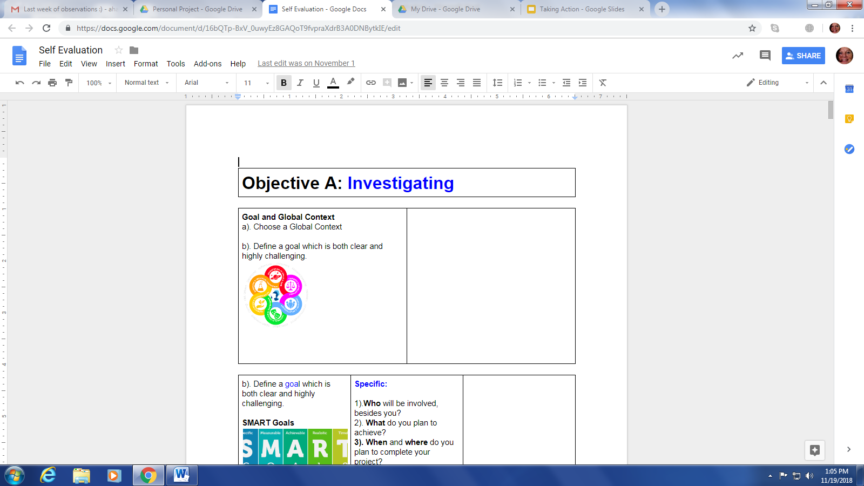
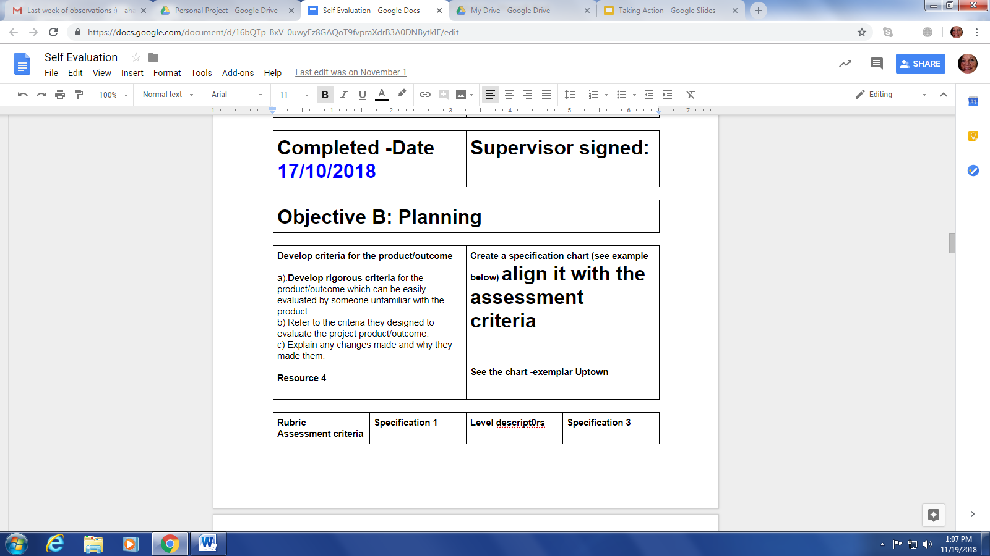
20th, November 2018-Form session
Deadlines Investigating and Planning should be completed and sent to your supervisor by Wednesday, 21st Nov. Parents will be notified if this document has not been completed, you have had plenty of time to achieve this. Screenshot evidence from process journal and add to the relevant sections.

Slide 2

Add the inquiry question here. Did you change it with your supervisor, to sound more inquiry based?

Slide 3
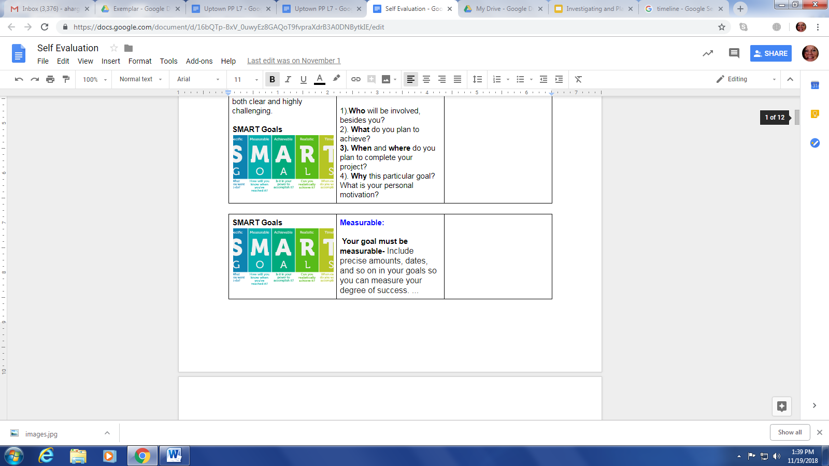
Complete the Smart Goals

Slide 4
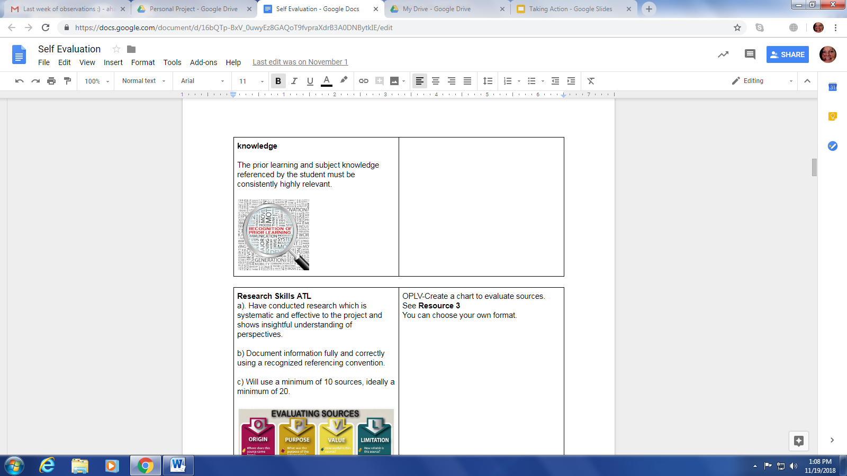
This section must show what prior subject specific knowledge you had.
For example-Scientific products might be science and maths, say why...

Slide 5
OPVL chart needs to show evidence of where your sources came from-origin. What purpose they have-are they valuable? What are the limitations?
Try and add colour, continuous text in the journal will still look like a diary entry.

Slide 6
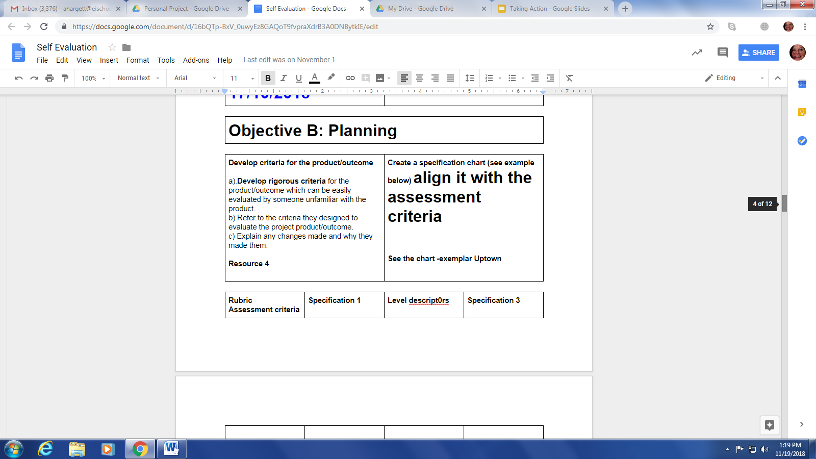
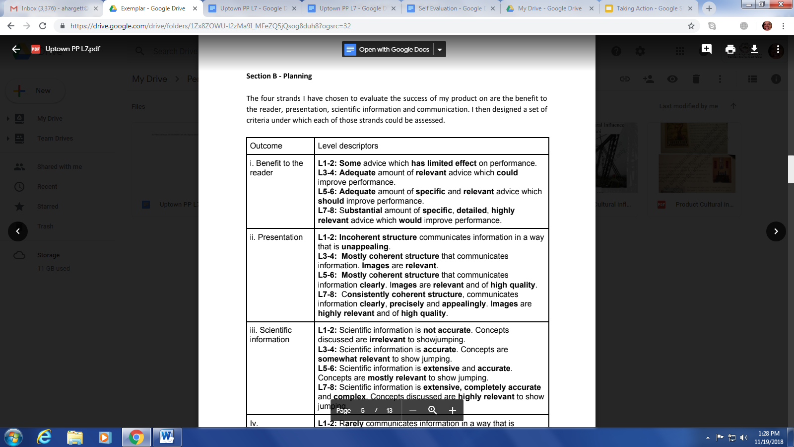
Have you created a specification sheet for your product? Have you included the marking criteria?

Slide 7
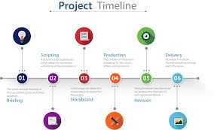
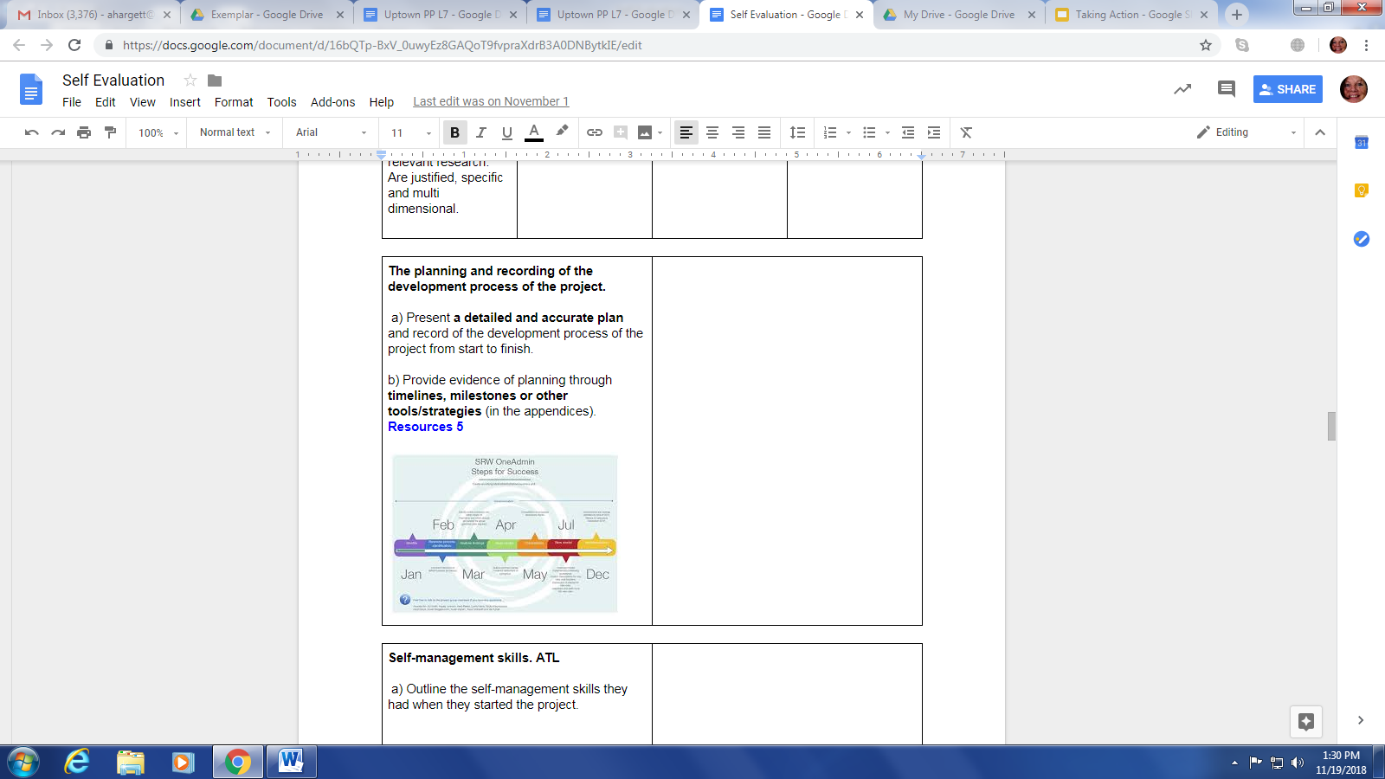
Have you created a timeline for planning the whole project? Have you shown evidence of not meeting deadlines? How did you overcome this?

Slide 8
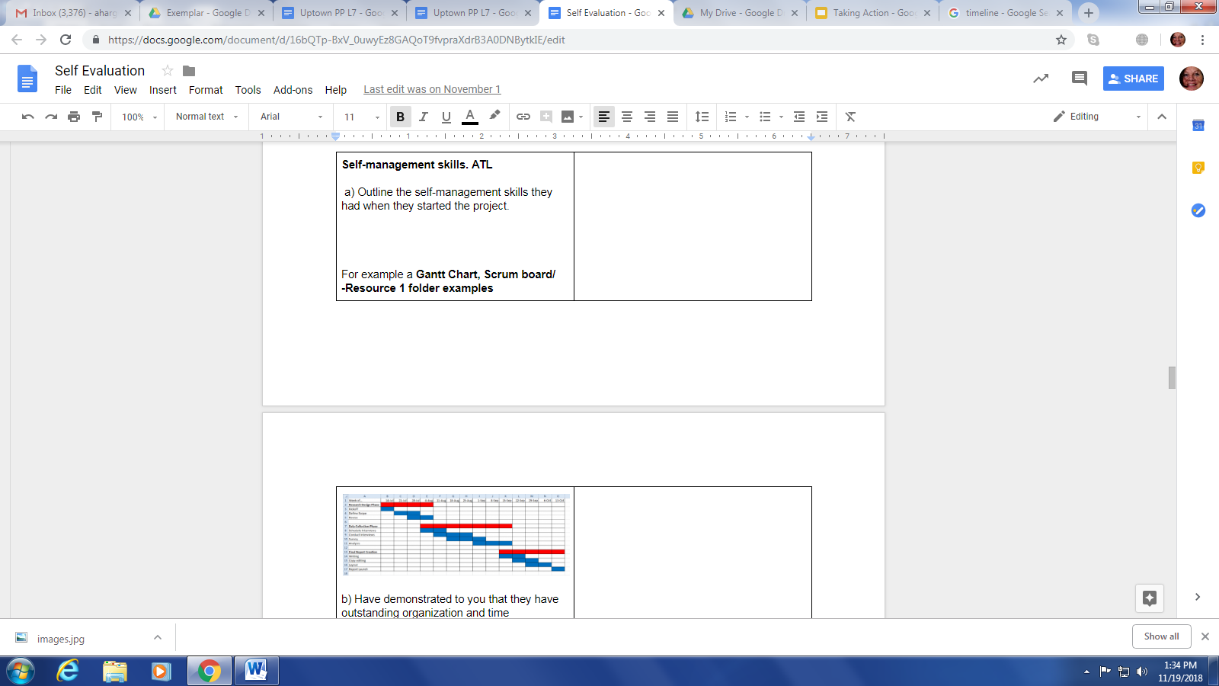
ATL Skills-self management
This is different to the previous planning timeline.
Look at a) b) c) and d)
Answer all these questions with the inclusion of a Gantt chart or similar

